Slide 1


Generative AI for Researchers
Synthetic data generation

Slide 2
Synthetic data generation

Slide 3
Synthetic data generation
Synthetic data is artificially created data that mimics real-world data patterns. It’s like a “pretend” version of actual data, designed to be statistically similar.
Unlike randomly generated numbers, synthetic data intentionally replicates key characteristics found in real-world datasets.

Slide 4
Why is Synthetic Data is needed?
No More Data Shortages: When real-world data is scarce or expensive (e.g., rare medical conditions or customer behavior for a new product), synthetic data fills the gap.
Privacy Protection: Using sensitive personal information can raise ethical concerns. Synthetic data allows AI training without compromising privacy.
Bias Buster: Real-world data often contains biases. Synthetic data helps create balanced datasets, providing a fairer view for AI models.
The “What-If” Trainer: Synthetic data lets you explore rare events and edge cases, preparing your AI for unpredictable situations.

Slide 5
Applications
Synthetic data isn’t just for machine learning; it finds applications in various domains.
Privacy-Preserving Research: Researchers can generate synthetic data to share publicly without revealing sensitive information. For instance, in healthcare, synthetic patient records allow studying diseases while protecting privacy.
Testing and Simulation:
Industries like aerospace, automotive, and robotics use synthetic data for testing and simulation. It helps evaluate designs, predict performance, and optimize systems.
Self-driving car companies simulate countless scenarios using synthetic data to train AI models.

Slide 6
Applications
Benchmarking Algorithms and Tools:
Synthetic data provides a controlled environment for evaluating algorithms, libraries, and tools. Researchers can compare performance objectively.
For example, testing database indexing strategies or evaluating compression techniques.
To make an idea about a real dataset before collecting it

Slide 7
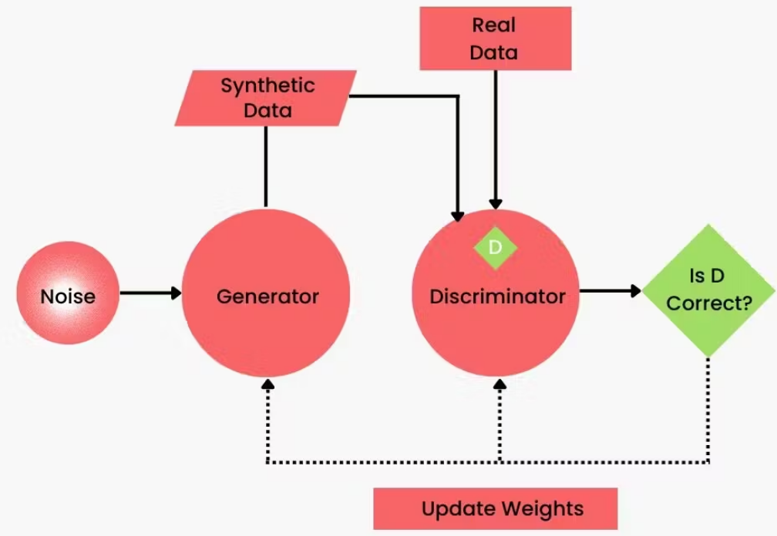
Methods to create Synthetic Data
Generative Adversarial Networks (GANs):
GANs are masters at creating realistic images and complex data.
They consist of two neural networks: a generator and a discriminator.
The generator creates synthetic data, while the discriminator evaluates its realism.
GANs have applications in image synthesis, style transfer, and more.

Slide 8
Methods to create Synthetic Data
Procedural Methods:
Think of these as following a recipe for data creation.
Procedural methods are great for structured data like addresses or financial records.
They allow precise control over data characteristics.

Slide 9
Methods to create Synthetic Data
imulation-Based Approaches:
Ideal for scenarios where physical rules matter.
For instance, training self-driving car AI involves simulating real-world events.
Simulation-based synthetic data ensures your AI understands complex environments

Slide 10
“Synthetic Data Cheat Sheet”
Generative Adversarial Networks (GANs):
Goal: Ultra-realistic visuals (e.g., medical images, fashion products, chatbot faces).
Real-World Case: Researchers used GANs for synthetic brain scans, aiding disease detection while protecting privacy.
Procedural Generation:
Goal: Large sets of structured data (customer records, financial transactions, website logs).
Real-World Case: E-commerce companies test website layout changes using procedural generation.
Simulation-Based:
Goal: AI that reacts to a physics-based world (robotics, self-driving cars, game development).
Real-World Case: Self-driving car companies train AI in hyper-realistic simulations.

Slide 11
Generating data using Large Language Models (LLMs)
Choose LLM Model
set up enviroment
define data requirements
create pormpt
generate data
review and refine
post processing

Slide 12
Generating data using Large Language Models (LLMs)
Choose an LLM: Select a suitable LLM, such as OpenAI's GPT-4, which is powerful and versatile for generating various types of data.
Set Up the Environment: Ensure you have access to the chosen LLM. This may involve using an API provided by the model's creators (e.g., OpenAI API for GPT-4).
Define the Data Requirements: Clearly outline what type of data you need. This could be structured (like tables) or unstructured (like text paragraphs).
Create Prompts: Design prompts that guide the LLM to generate the desired data. Prompts should be specific and detailed to get accurate outputs. For example, if you need customer reviews, a prompt might be: "Generate a positive customer review for a smartphone."
Generate Data: Use the prompts to generate data. You can automate this process by writing scripts that call the LLM's API and store the generated data.
Review and Refine: Evaluate the generated data for quality and relevance. Refine your prompts or adjust the model parameters (like temperature and max tokens) to improve the outputs.
Post-Processing: Process the generated data as needed. This might include cleaning, structuring, or formatting the data to meet your specific requirements.

Slide 13
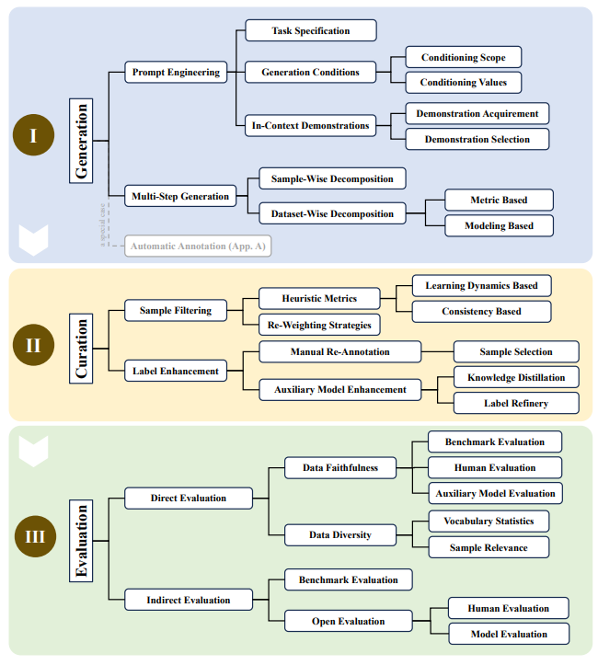
A taxonomy of LLMs-driven synthetic data generation, curation, and evaluation
Long, Lin, et al. "On LLMs-driven synthetic data generation, curation, and evaluation: A survey." arXiv preprint arXiv:2406.15126 (2024).

Slide 14
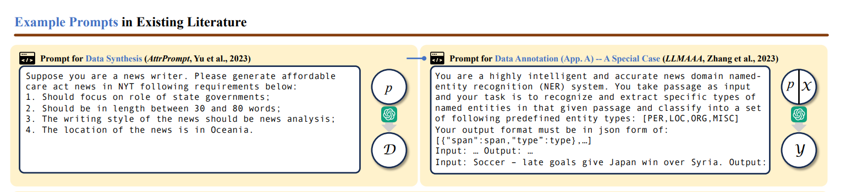
Example prompts for data generation in the literature
Long, Lin, et al. "On LLMs-driven synthetic data generation, curation, and evaluation: A survey." arXiv preprint arXiv:2406.15126 (2024).

Slide 15
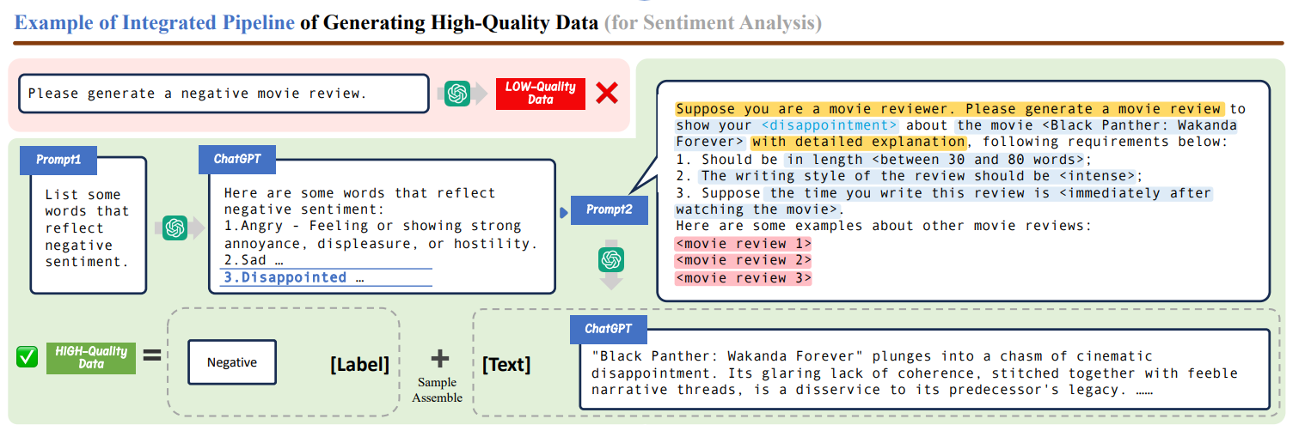
High quality data generation
Long, Lin, et al. "On LLMs-driven synthetic data generation, curation, and evaluation: A survey." arXiv preprint arXiv:2406.15126 (2024).

Slide 16
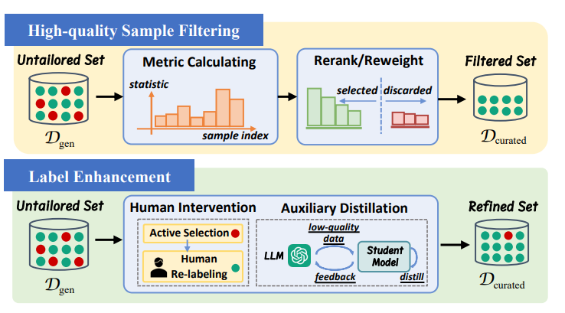
Two dominant approaches of data curation
Long, Lin, et al. "On LLMs-driven synthetic data generation, curation, and evaluation: A survey." arXiv preprint arXiv:2406.15126 (2024).

Slide 17
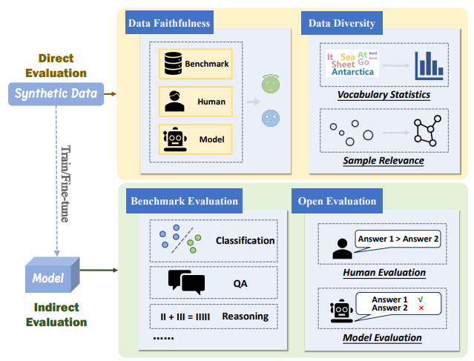
Direct and indirect methods of data evaluation
Long, Lin, et al. "On LLMs-driven synthetic data generation, curation, and evaluation: A survey." arXiv preprint arXiv:2406.15126 (2024).

Slide 18
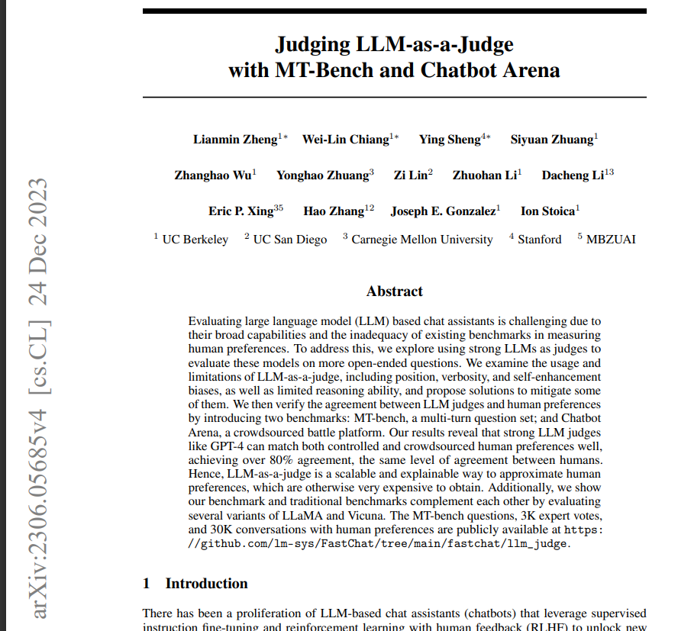
Use LLM as a judge to evaluate the quality
Use LLM as a judge to evaluate the quality of generated data
LLM-as-a-Judge, leveraging OpenAI's `gpt-4o` as an impartial judge (though we could have used any LLM to act as a judge), to compare the quality of data generated by the models below against human expert curated data from the

Slide 19
Open AI cookbook Synthetic data generation
CSV with a structured prompt
Multitable CSV with a python program
creating textual data

Slide 20
CSV with a structured prompt
"""
Create a CSV file with 10 rows of housing data.
Each row should include the following fields:
- id (incrementing integer starting at 1)
- house size (m^2)
- house price
- location
- number of bedrooms
Make sure that the numbers make sense (i.e. more rooms is usually bigger size, more expensive locations increase price. more size is usually higher price etc. make sure all the numbers make sense). Also only respond with the CSV.
"""

Slide 21
result
```csv
id,house_size_m2,house_price,location,number_of_bedrooms
1,50,150000,Suburban,2
2,75,250000,City Center,3
3,100,350000,Suburban,4
4,120,450000,Suburban,4
5,80,300000,City Center,3
6,90,400000,City Center,3
7,150,600000,Premium Area,5
8,200,750000,Premium Area,5
9,55,180000,Suburban,2
10,300,950000,Premium Area,6
```

Slide 22
Multitable CSV with a python program
"""
Create a Python program to generate 3 different pandas dataframes.
1. Housing data
I want 100 rows. Each row should include the following fields:
- id (incrementing integer starting at 1)
- house size (m^2)
- house price
- location
- number of bedrooms
- house type
+ any relevant foreign keys
2. Location
Each row should include the following fields:
- id (incrementing integer starting at 1)
- country
- city
- population
- area (m^2)
+ any relevant foreign keys
3. House types
- id (incrementing integer starting at 1)
- house type
- average house type price
- number of houses
+ any relevant foreign keys
Make sure that the numbers make sense (i.e. more rooms is usually bigger size, more expensive locations increase price. more size is usually higher price etc. make sure all the numbers make sense).
Make sure that the dataframe generally follow common sense checks, e.g. the size of the dataframes make sense in comparison with one another.
Make sure the foreign keys match up and you can use previously generated dataframes when creating each consecutive dataframes.
You can use the previously generated dataframe to generate the next dataframe.
"""

Slide 23
creating textual data
"""
I am creating input output training pairs to fine tune my gpt model. The usecase is a retailer generating a description for a product from a product catalogue. I want the input to be product name and category (to which the product belongs to) and output to be description.
The format should be of the form:
1.
Input: product_name, category
Output: description
2.
Input: product_name, category
Output: description
Do not add any extra characters around that formatting as it will make the output parsing break.
Create as many training pairs as possible.
"""

Slide 24
result
1.
Input: Wireless Bluetooth Headphones, Electronics
Output: Immerse yourself in high-quality sound with these Wireless Bluetooth Headphones, featuring active noise cancellation and a comfortable over-ear design for extended listening sessions.
2.
Input: Organic Green Tea, Beverages
Output: Enjoy a refreshing cup of Organic Green Tea, sourced from the finest leaves, packed with antioxidants, and perfect for a healthy, invigorating boost anytime.
3.
Input: Stainless Steel Kitchen Knife, Kitchenware
Output: Cut with precision and ease using this Stainless Steel Kitchen Knife, designed with an ergonomic handle and a sharp blade for all your culinary tasks.
4.
Input: Hiking Backpack, Outdoor Gear
Output: Explore the great outdoors with this durable Hiking Backpack, featuring multiple compartments for optimal organization and a breathable design for ultimate comfort on long treks.
5.
Input: Air Fryer, Kitchen Appliances
Output: Cook your favorite meals with less oil using this Air Fryer

Slide 25
Tools
https://gretel.ai

Slide 26
Updated materials
https://github.com/motazsaad/Gen-AI-for-Researchers

Slide 27


Q&A

